Slide 1

Rows and Columns in file
Rows in file = 12
Columns in file = 5

Slide 2

Rows 3-8

Slide 3
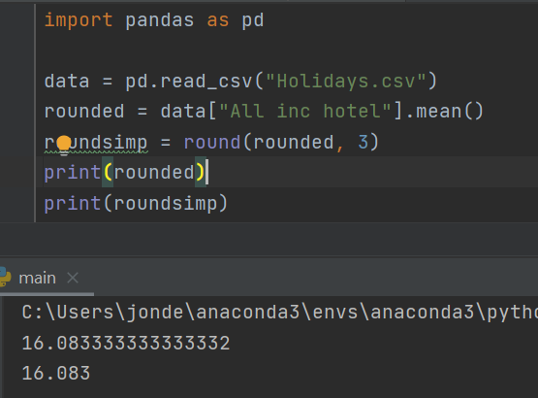
Mean number of all-inclusive hotels within each destination
There are approximately 16 all inclusive hotels within each destination.

Slide 4
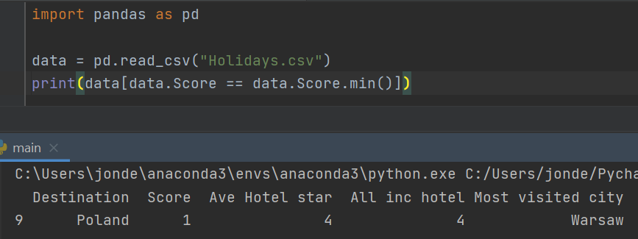
Lowest Scoring Destination
The lowest scoring destination was Poland with a score of just 1 point.

Slide 5
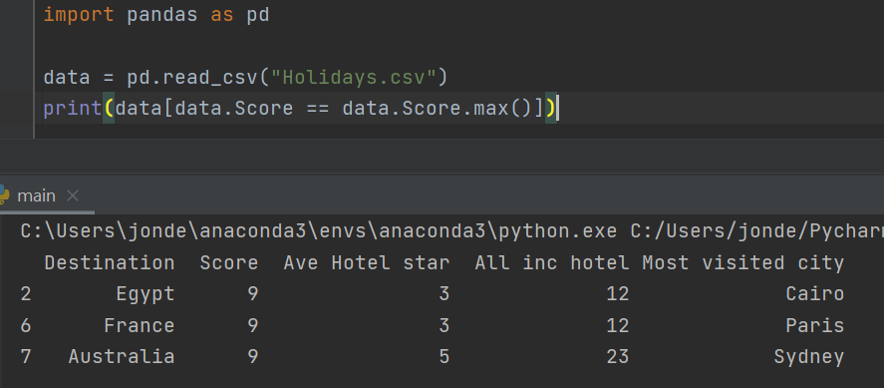
Joint Highest Scoring Destinations
Egypt, France and Australia ALL scored 9 points as a holiday destination.

Slide 6
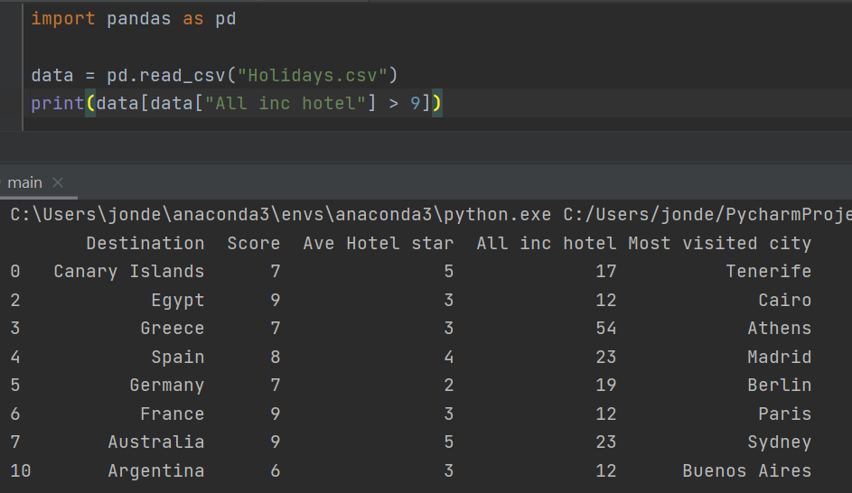
Destinations where there are more than 9 all-inclusive hotels
8 out of 12 Destinations boast more than 9 all inclusive hotels in their region.

Slide 7
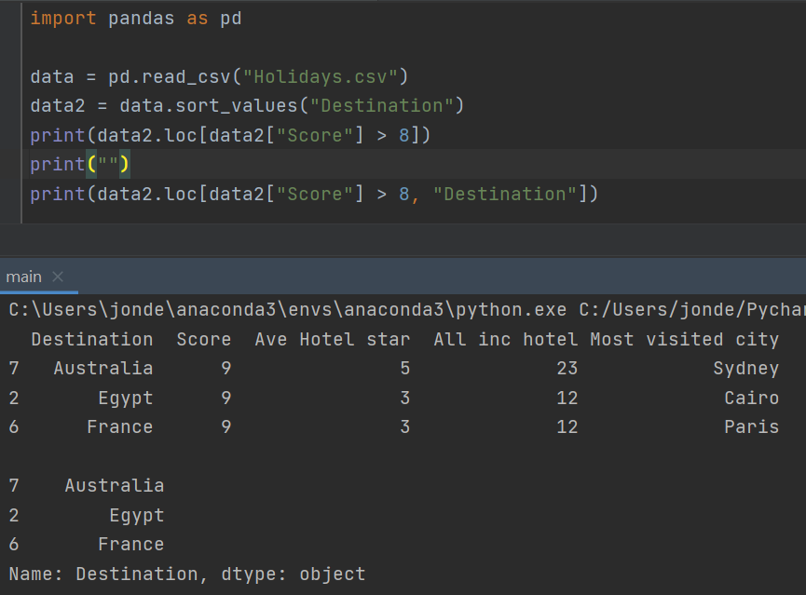
Destinations with scores over 8
Australia, Egypt and France all scored over 8 for their destinations.

Slide 8

Destinations with score below 2
Poland was the only Destination to score less than 2.

Slide 9
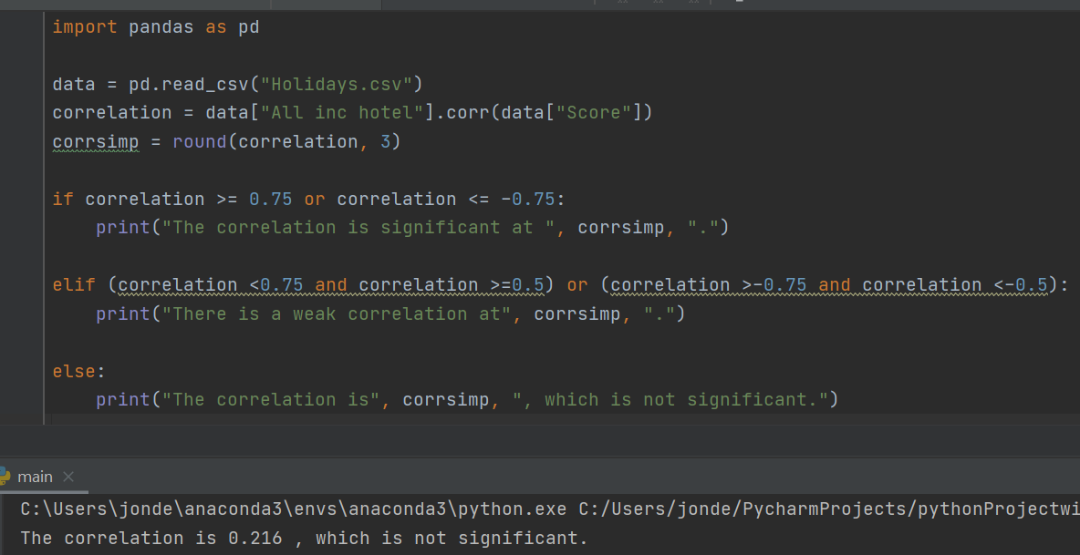
Correlation between number of all inclusive hotels in a region and score?
The correlation coefficient between region and score was 0.216 which is very low.
There is no significant correlation between the number of all inclusive hotels at a Destination and Score.

Slide 10
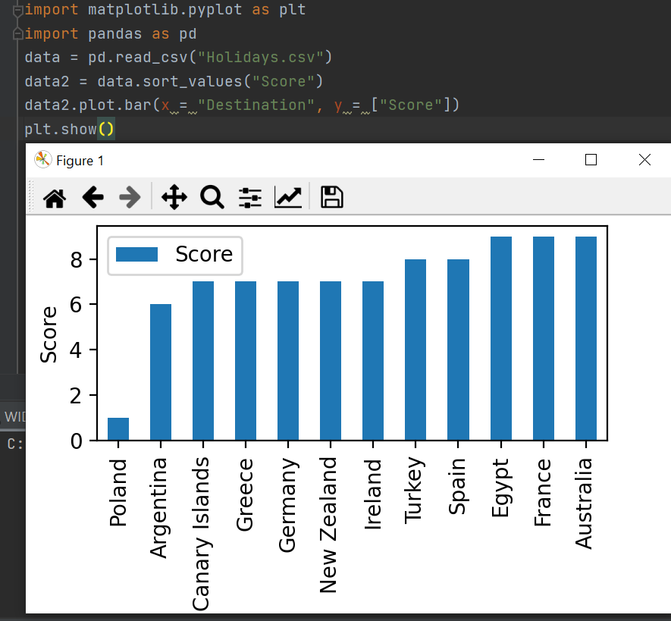
Destination/ Highest Scores Chart
Poland is a clear underperforming outlier with a considerably worse score than all other Destinations.

